Slide 1


Slide 2
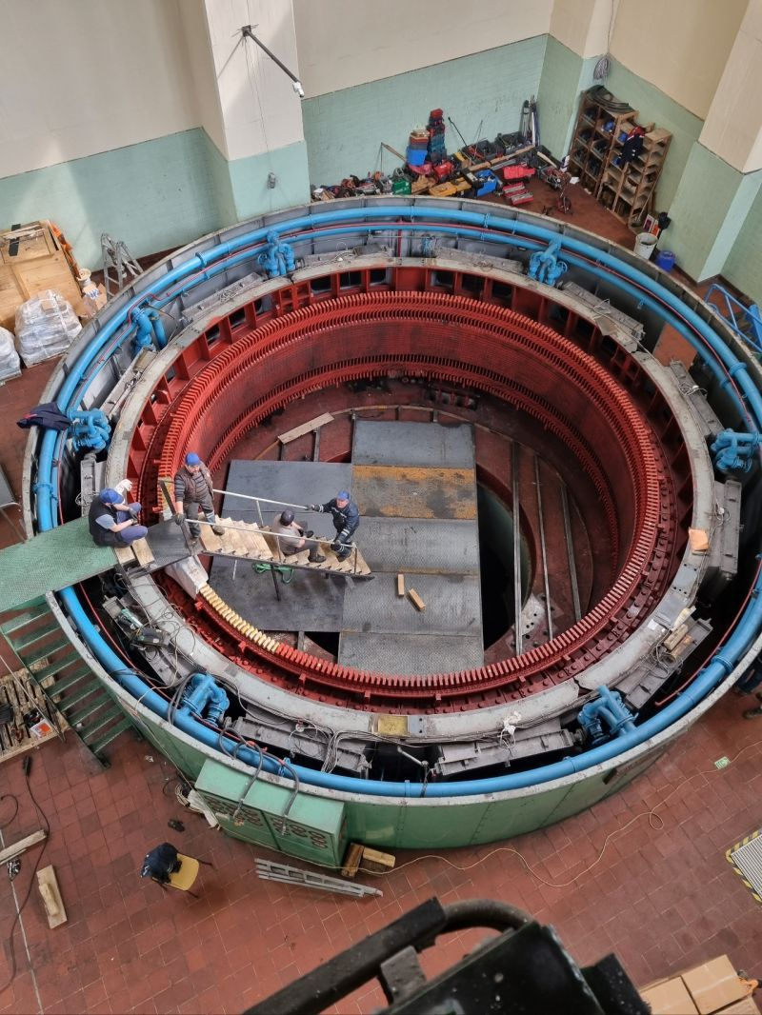
REFURBISHMENT & ALTERNATING WINDING TYPE OF A 44 MVA HYDRO GENERATOR
M. Samet YAKUT
Advisor: Assoc. Prof. Ozan Keysan
November 23, 2023
EE590 Seminar, METU EE Dep.

Slide 3
Outline
Introduction
Basic Terms & Definitions
Refurbishment Process
Optimization
Design of Windings
Conclusion

Slide 4
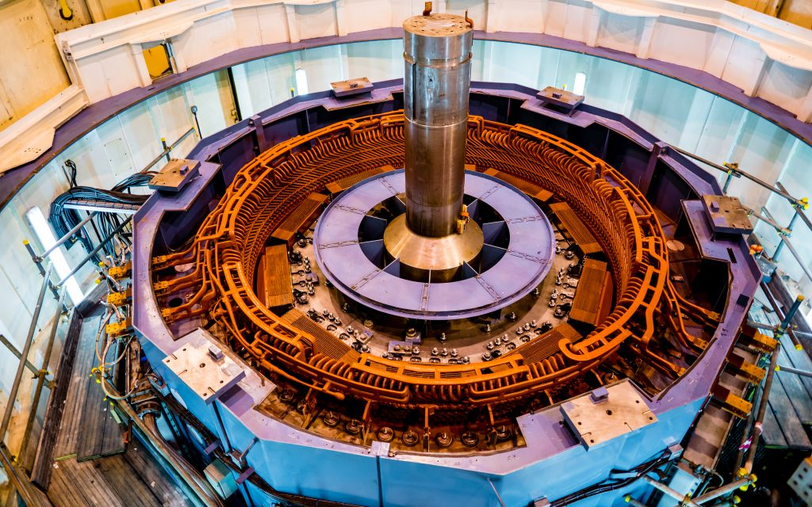
Hydro Generators
Largest low carbon energy resource
Salient pole synchronous machines
High voltage stator
Tens of kVA to hundreds of MVA
IEA, Low-carbon electricity generation by technology, 2020, IEA, Paris https://www.iea.org/data-and-statistics/charts/low-carbon-electricity-generation-by-technology-2020, IEA. Licence: CC BY 4.0
Notes:
Total installed higher than 4000 TWh
Higher than sum of all the other renewables
Varying airgap wrt position
High voltage induced due to rotating field created by rotor
Outer diameter may reach 10s of meter depending on output power

Slide 5
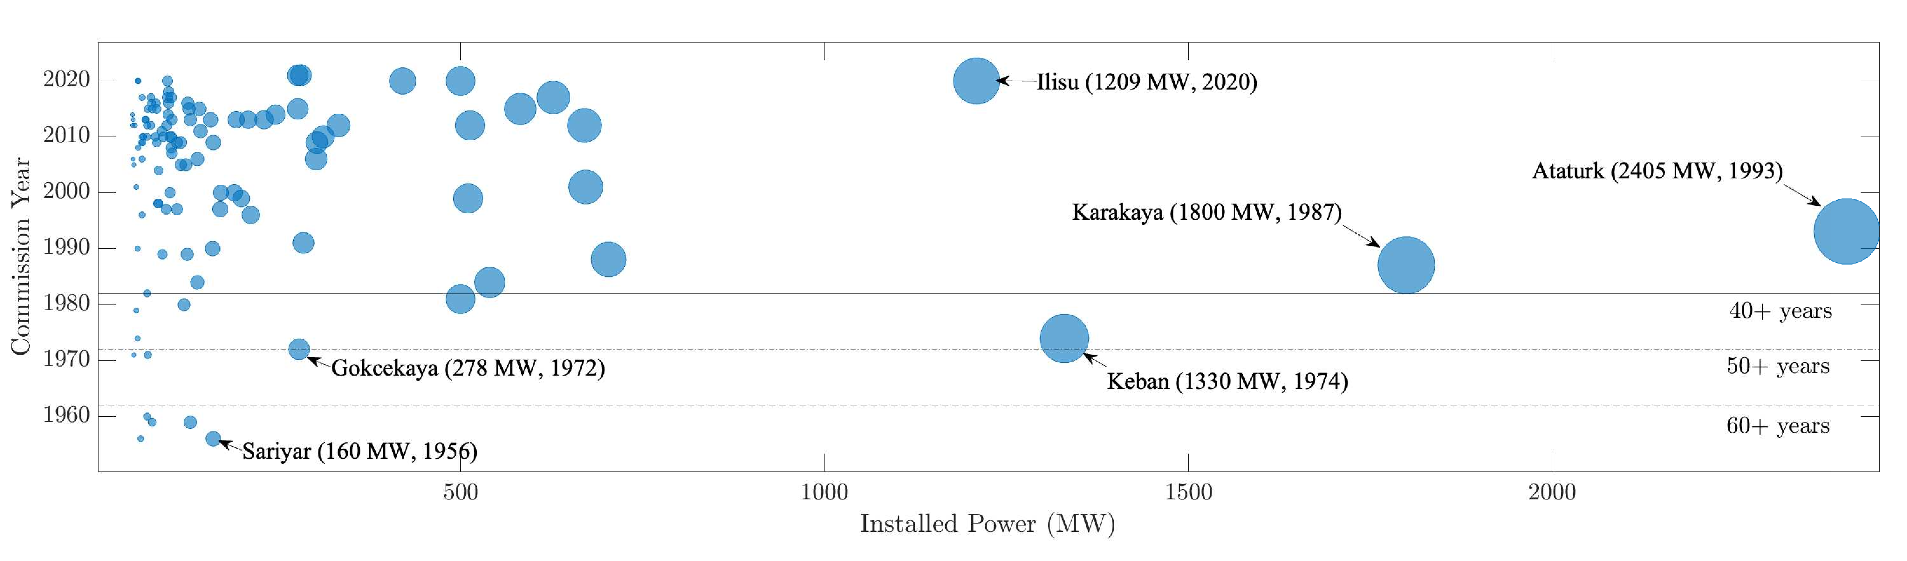
Refurbishment
Installed capacity older than 30 years: 6205 MWs
which accounts for 31.9% of large hydro generators
Most old generators are over – designed
cheapest way of increasing installed power
N. Tosun, G. Gülletutan, M. S. Yakut, D. Alp Yilmaz, Ö. Bayer and O. Keysan, "Winding Type Alternation of a Refurbished Old Generator," 2023 IEEE Workshop on Electrical Machines Design, Control and Diagnosis (WEMDCD), Newcastle upon Tyne, United Kingdom, 2023, pp. 1-6, doi: 10.1109/WEMDCD55819.2023.10110941.
Notes:
re-producing the generator w or w/o modifications
in Turkey

Slide 6
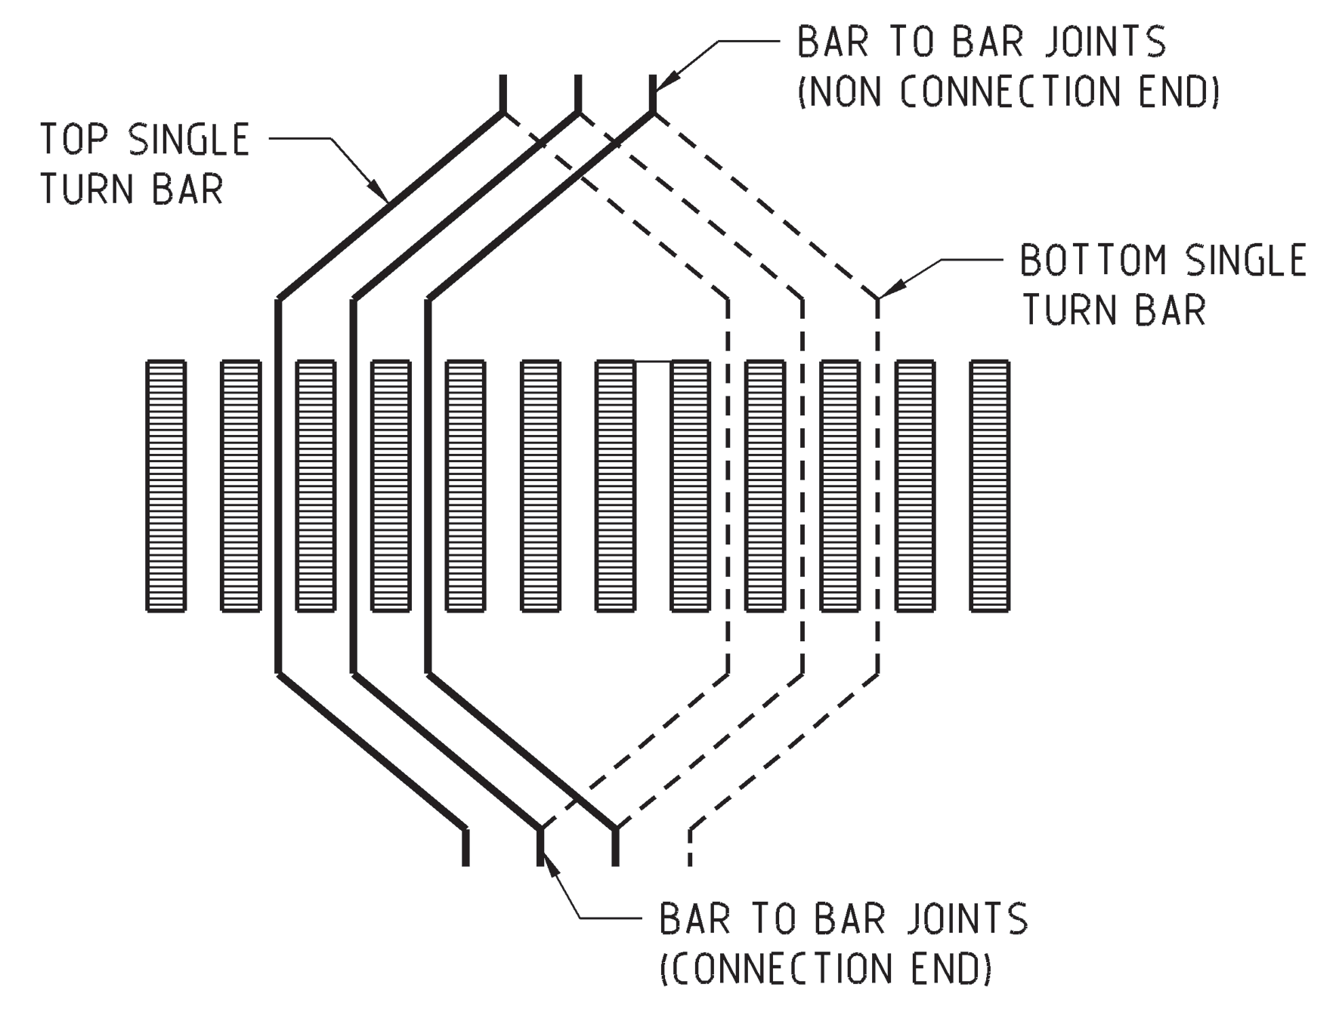
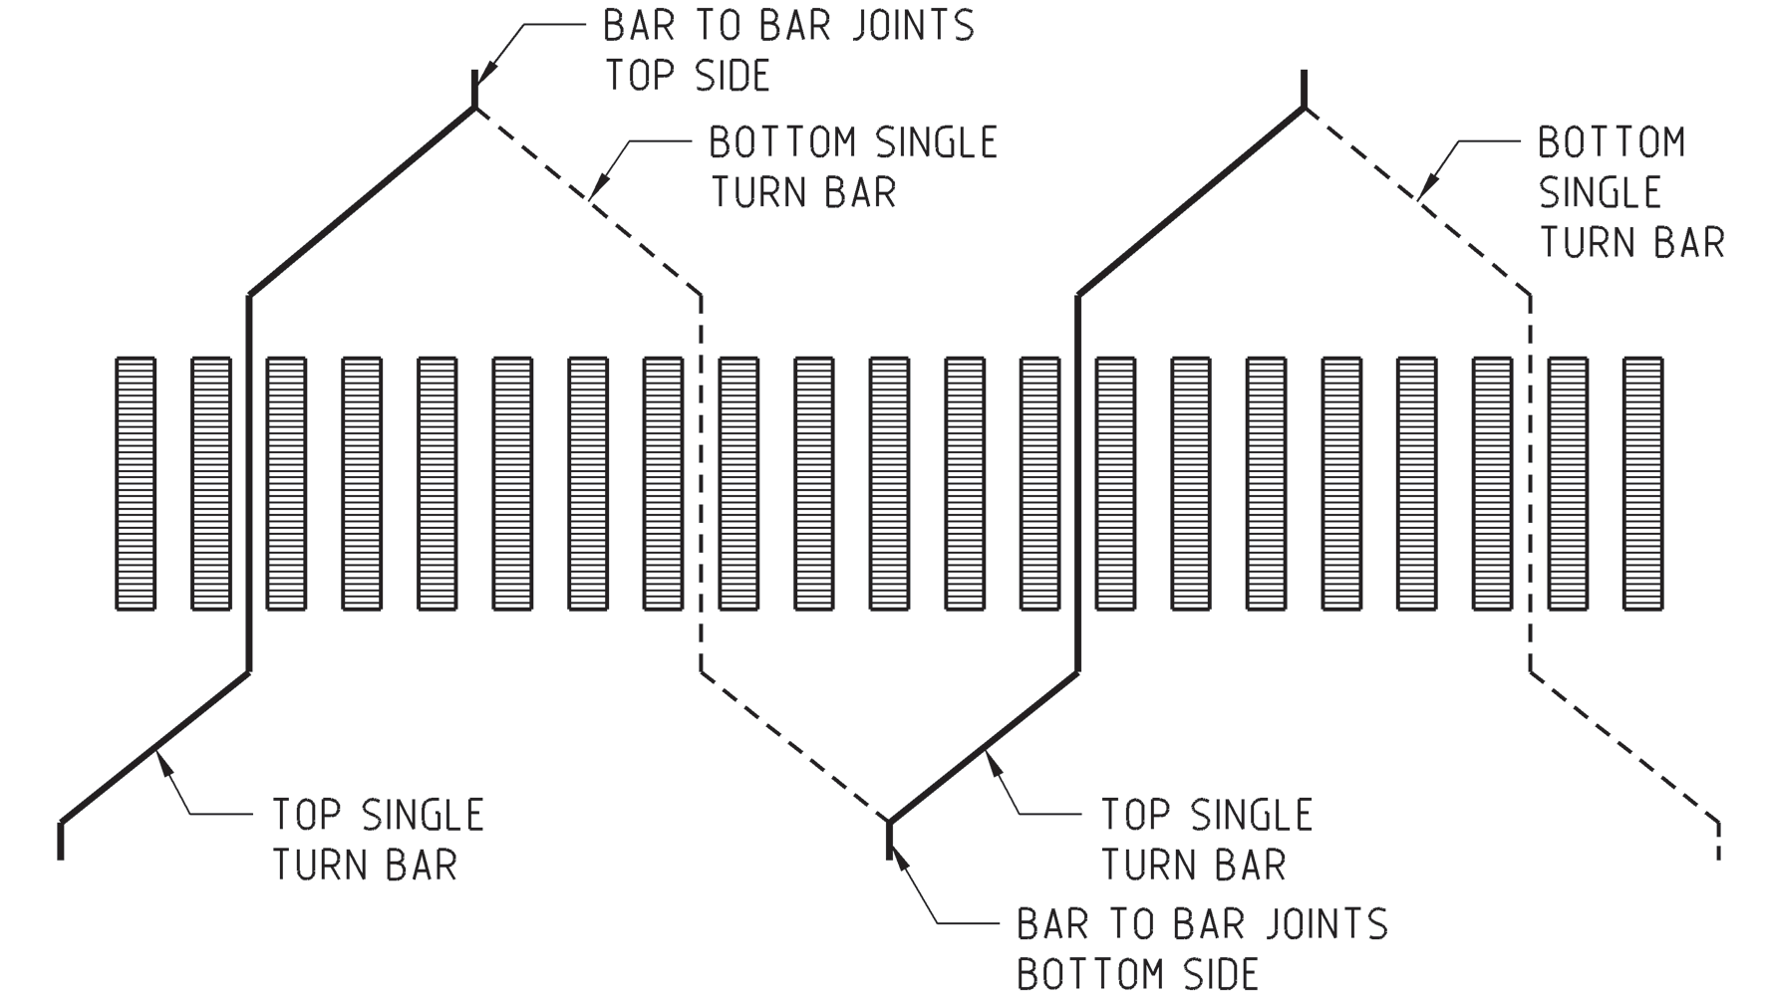
Winding Types
Lap Winding Wave Winding
M.M. Znidarich (2008) Hydro Generator High Voltage Stator Windings: Part 1 – Essential Characteristics and Degradation Mechanisms, Australian Journal of Electrical and Electronics Engineering, 5:1, 1-17, DOI: 10.1080/1448837X.2008.11464196
Notes:
Closed turn – open single turn
Selection depends production habit

Slide 7
Winding Types
Wave Winding
Less outage duration
Simple end connection
Low number of external connections
Lap Winding
Simple winding schematic design
Less type of coils
Allows bypass

Slide 8
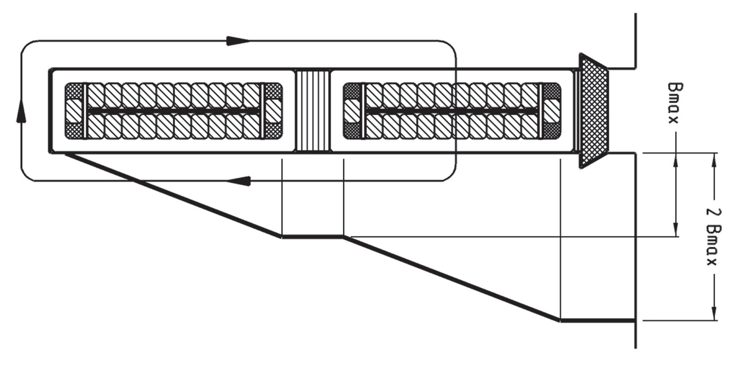
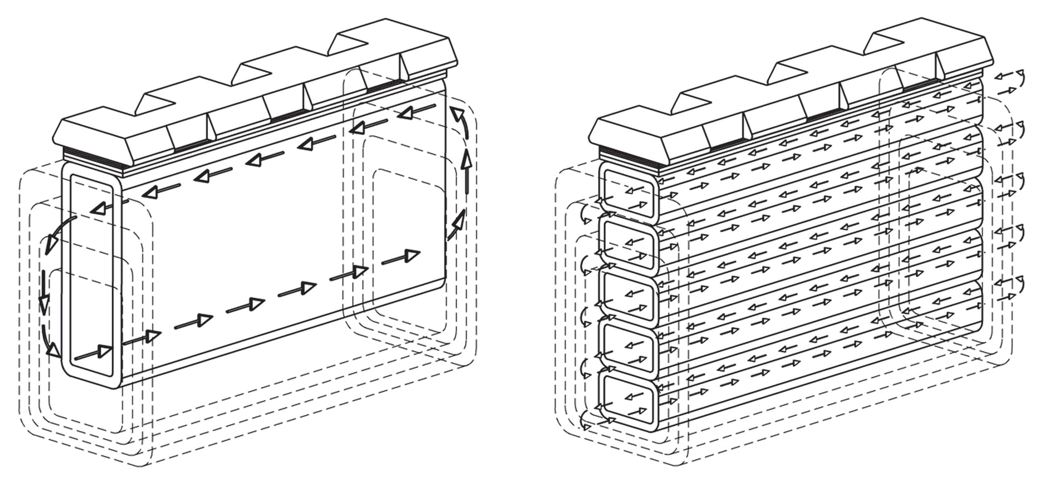
Roebel Bars
Different induced voltages in each strand
Circulating currents
Eddy losses
Notes:
Name comes from the inventor
Due to slot leakage flux
To reduce the extra losses, transposition of strands are applied

Slide 9
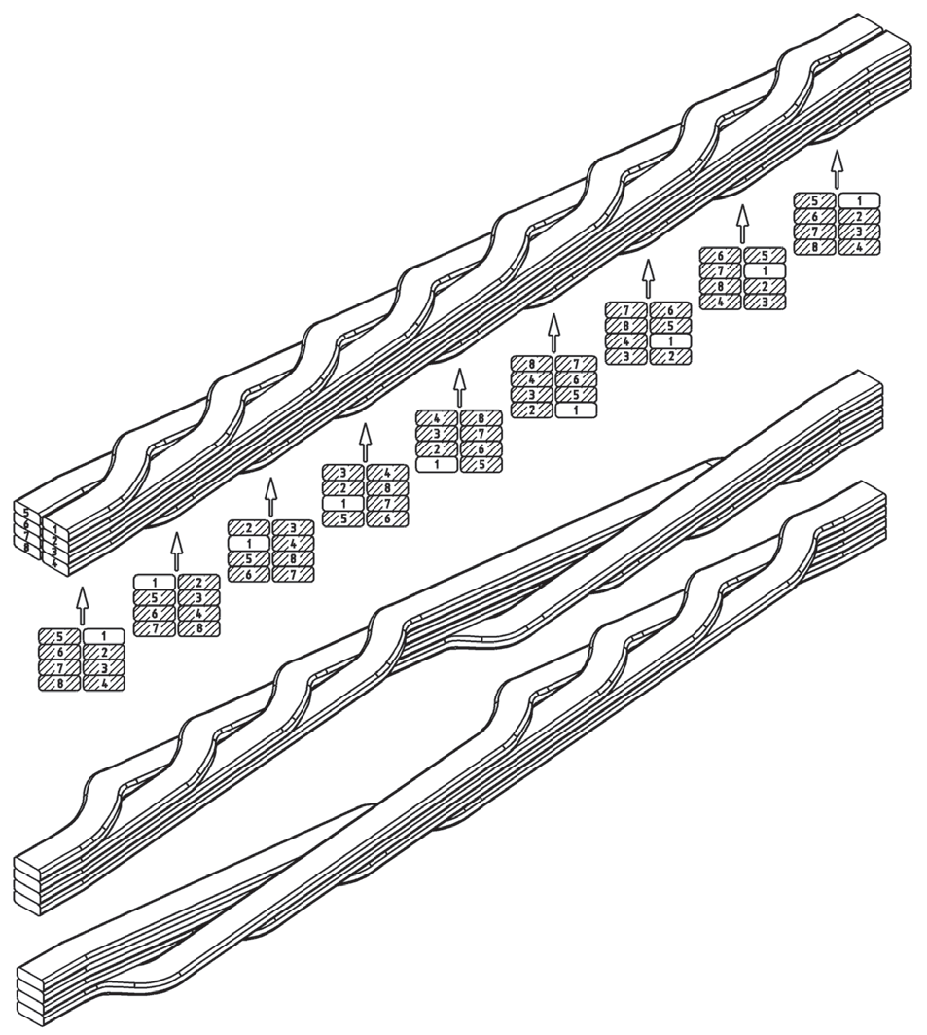
Roebel Bars
Transposition is applied to minimize circulating currents
Common transposition angles: 180, 360, 540 and 720
Transposed in active region
Notes:
With the help of transposition, induced voltages are more less equalized
Transposition angle is limited by axial length

Slide 10
Problem Definition
Refurbishment of an old 44 MVA hydro generator by changing winding type from lap to wave
Constraints
Constant outer diameter
Same rotor geometry
Generator under concern is installed in 1966, Sarıyar, Ankara by Westinghouse Electric Co.

Slide 11
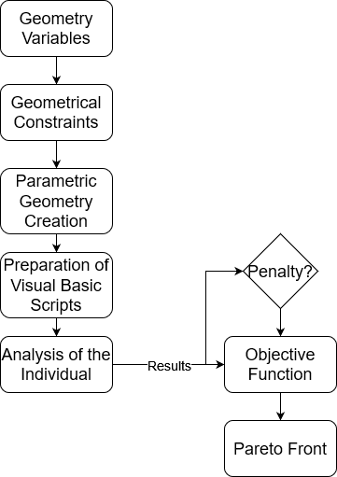

Optimization: Method
NSGA – II
Variables are machine geometry parameters
Simulations in RMxprt
Notes:
NSGA – II due to highly non-linear problem

Slide 12
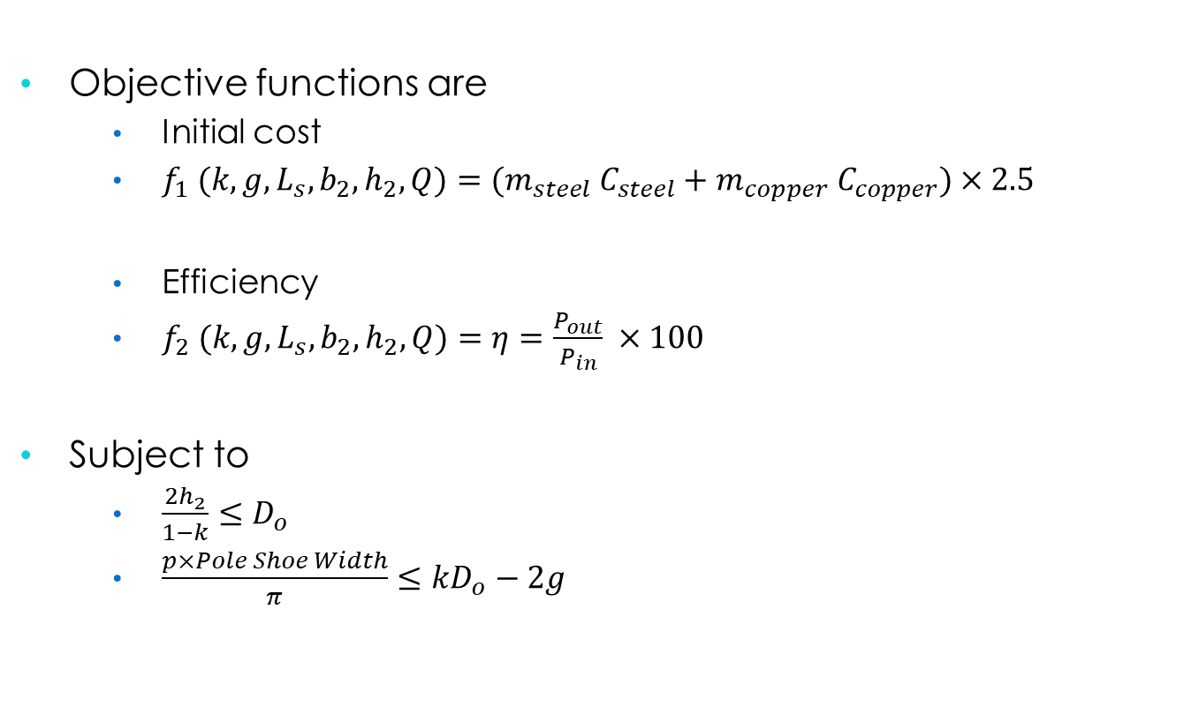
Optimization: Objective Function
Objective functions are
Initial cost
$f_{1} (k,g,L_{s},b_{2},h_{2},Q)={(m}_{steel} C_{steel}+m_{copper} C_{copper})×2.5$
Efficiency
$f_{2} (k,g,L_{s},b_{2},h_{2},Q)=η=\frac{P_{out}}{P_{in}} ×100$
Subject to
$\frac{2h_{2}}{1−k}≤D_{o}$
$\frac{p×Pole Shoe Width}{π}≤kD_{o}−2g$
Notes:
Wastage material throughout the manufacturing is included in material cost.

Slide 13
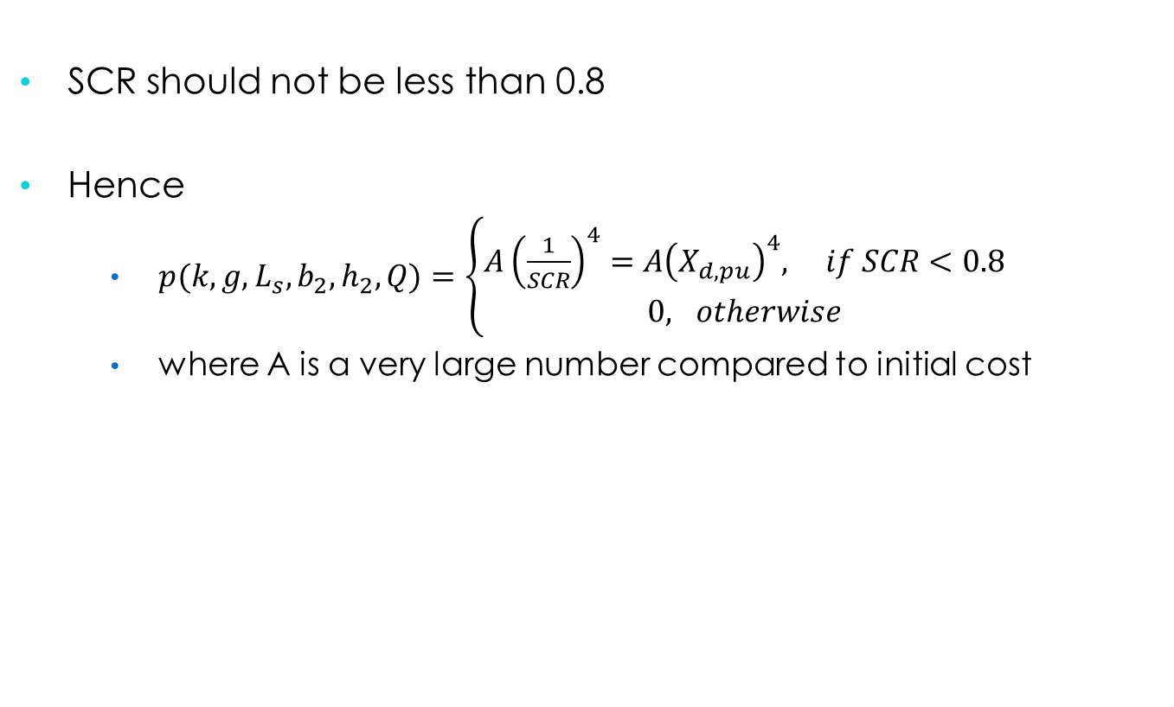
Optimization: Penalty Function
SCR should not be less than 0.8
Hence
$p(k,g,L_{s},b_{2},h_{2},Q)=\left\{\begin{aligned}A{\left(\frac{1}{SCR}\right)}^{4}=A{\left(X_{d,pu}\right)}^{4}, if SCR<0.8 \\ 0, otherwise\end{aligned}\right.$
where A is a very large number compared to initial cost
Glenn Mottershead; Stefano Bomben; Isidor Kerszenbaum; Geoff Klempner, "OPERATION AND CONTROL," in Handbook of Large Hydro Generators: Operation and Maintenance , IEEE, 2021, pp.177-240, doi: 10.1002/9781119524205.ch4.
Notes:
Define SCR: metric of stability

Slide 14
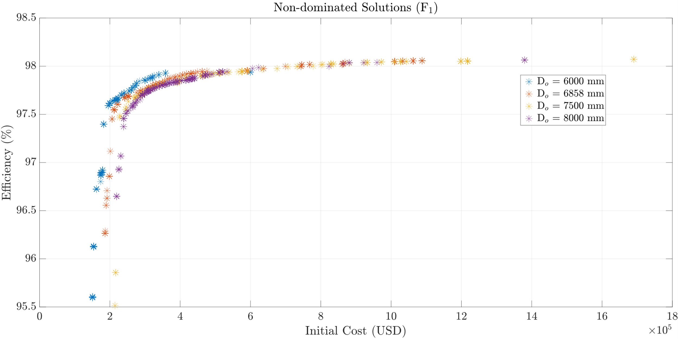
Optimization: Results
Notes:
Multiple outer diameters to see trend
Nominal diameter = 6858 mm
98% efficiency constraint

Slide 15
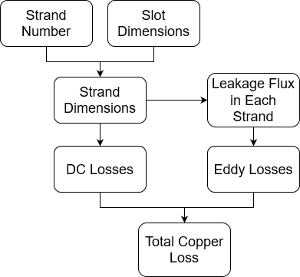
Design of Roebel Bars
Strand number is swept
Strand dimensions are calculated by including manufacturing details
AC and DC resistances are also calculated

Slide 16
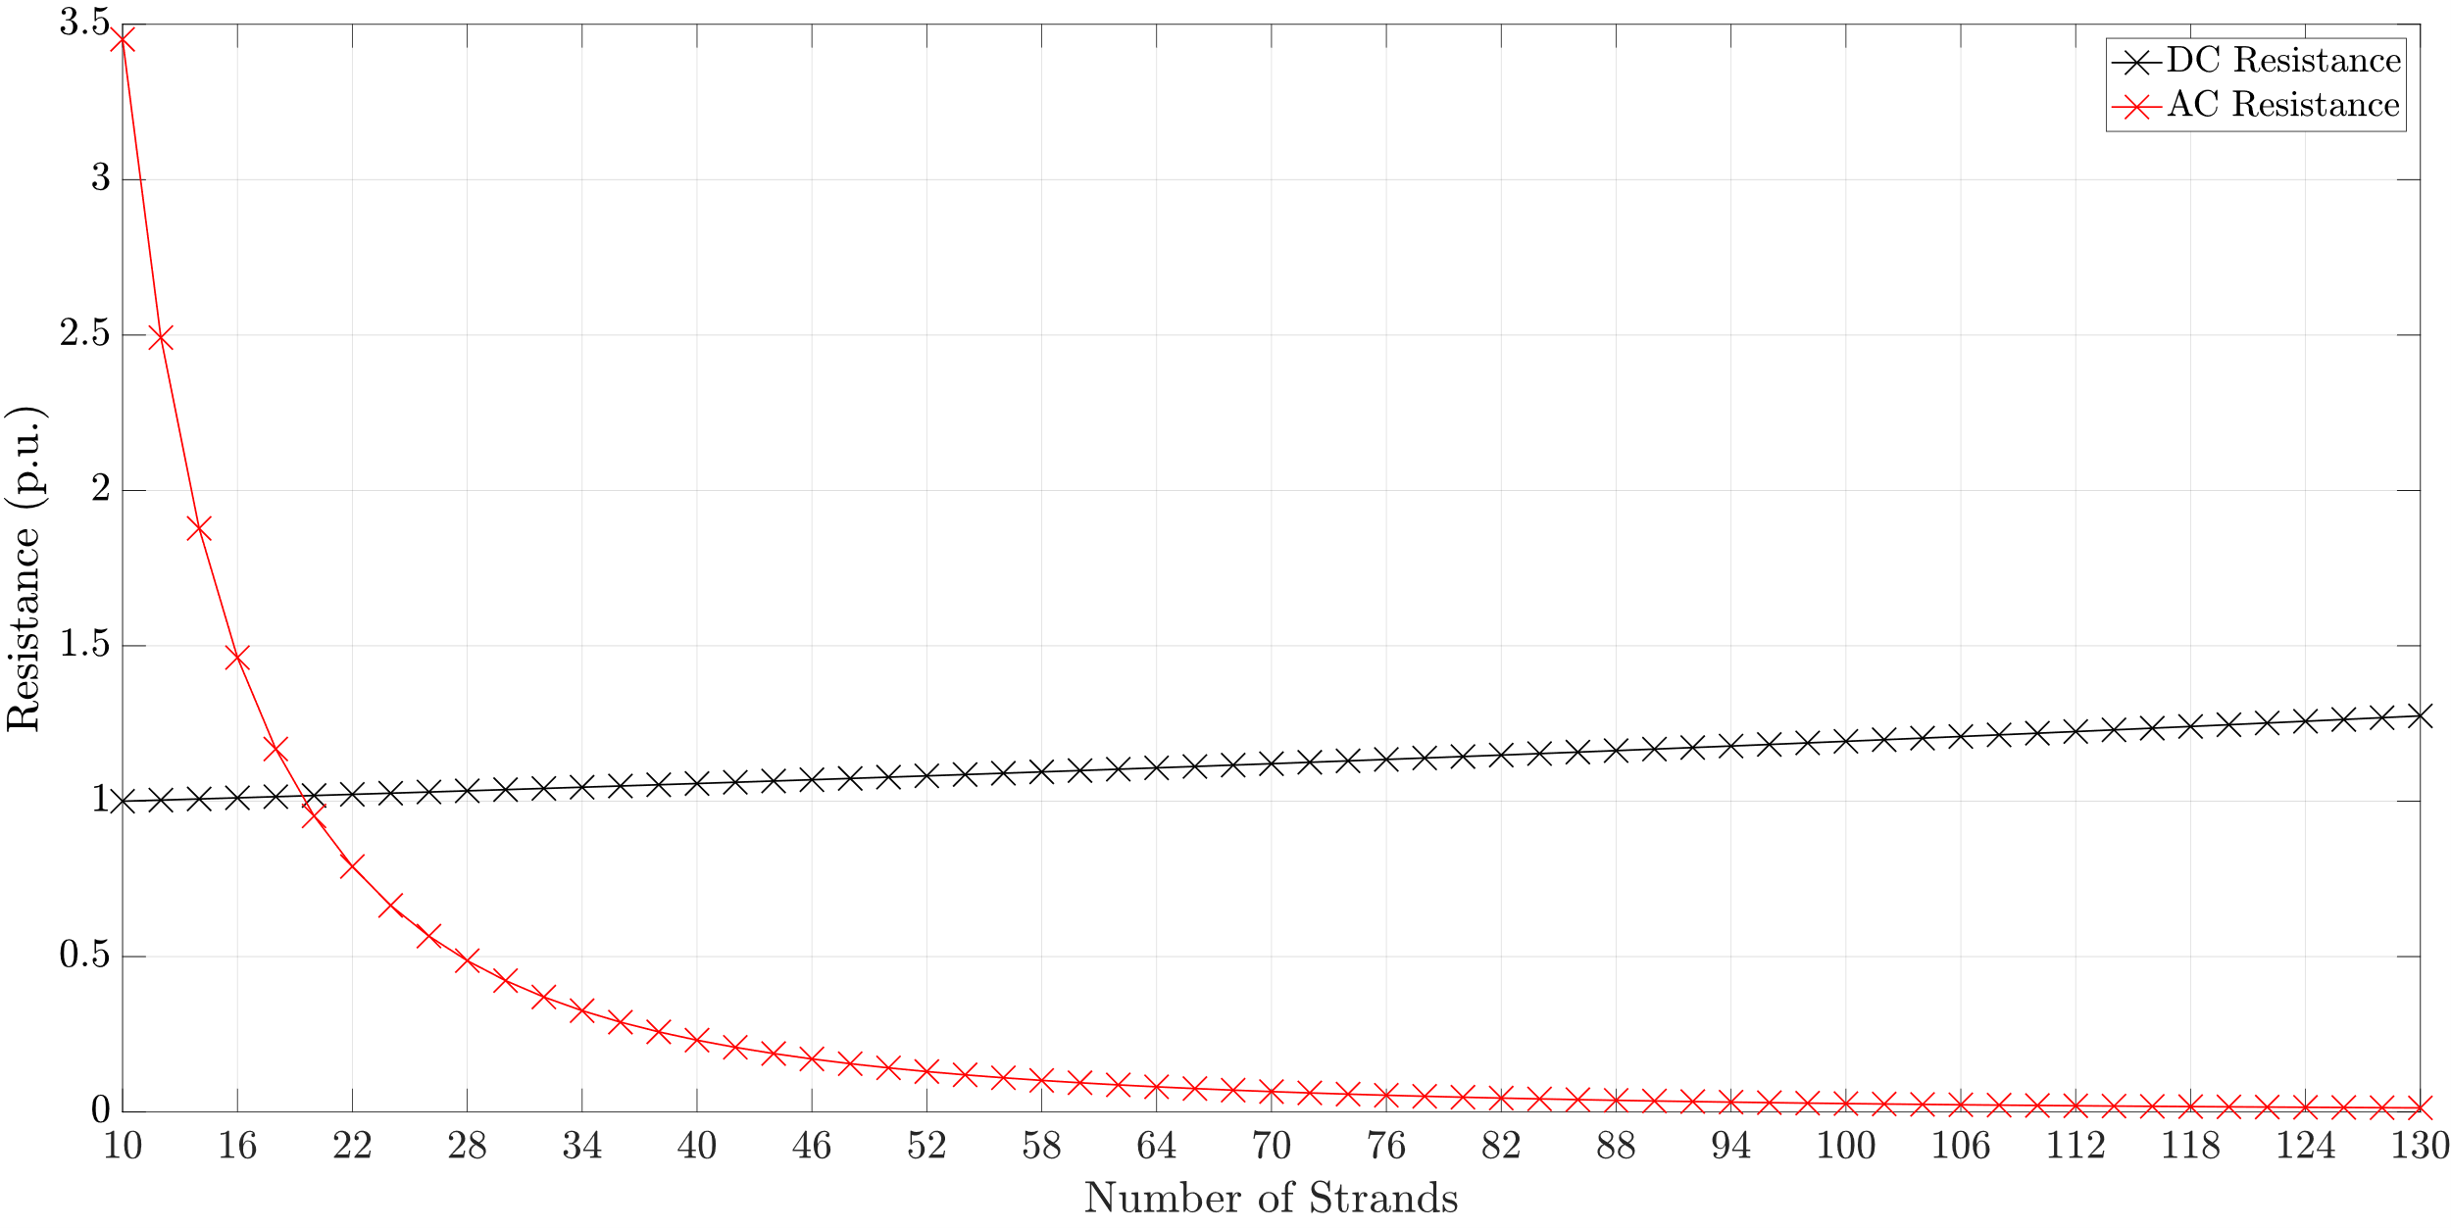
Design of Roebel Bars
$$D_{o}=6858 mm, k=0.9,g=18 mm, L_{s}=925 mm, b_{2}=22 mm, h_{2}=152 mm, Q=300$$

Slide 17
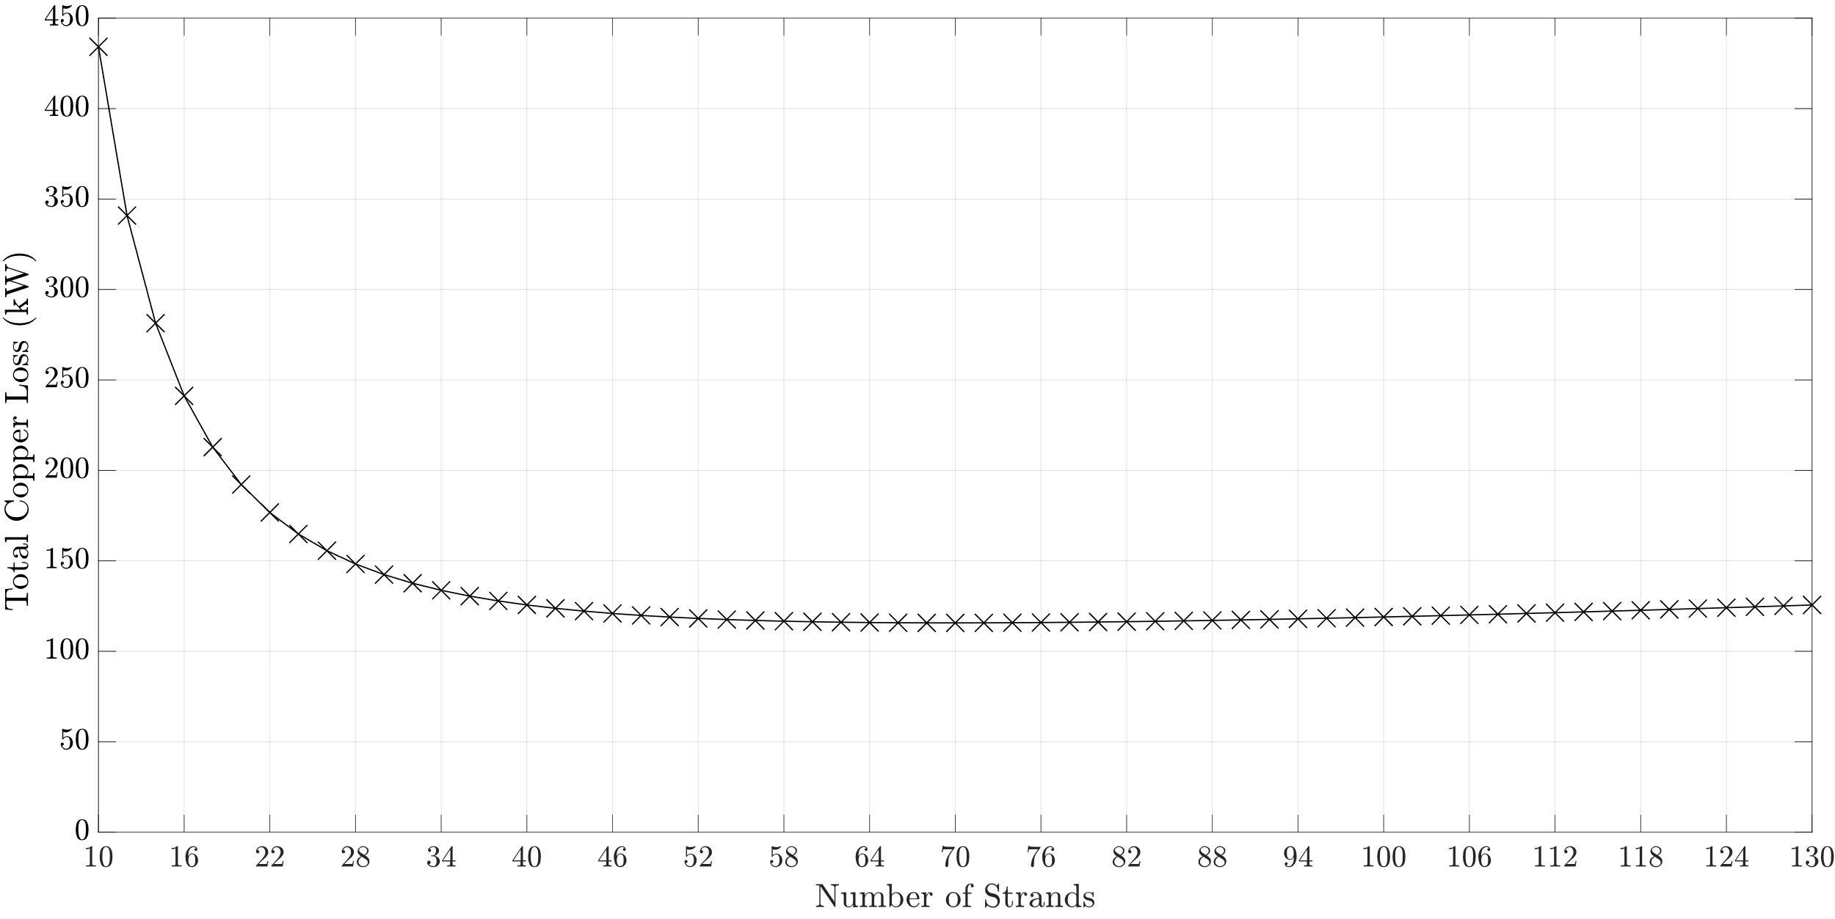
Design of Roebel Bars
$$D_{o}=6858 mm, k=0.9,g=18 mm, L_{s}=925 mm, b_{2}=22 mm, h_{2}=152 mm, Q=300$$

Slide 18
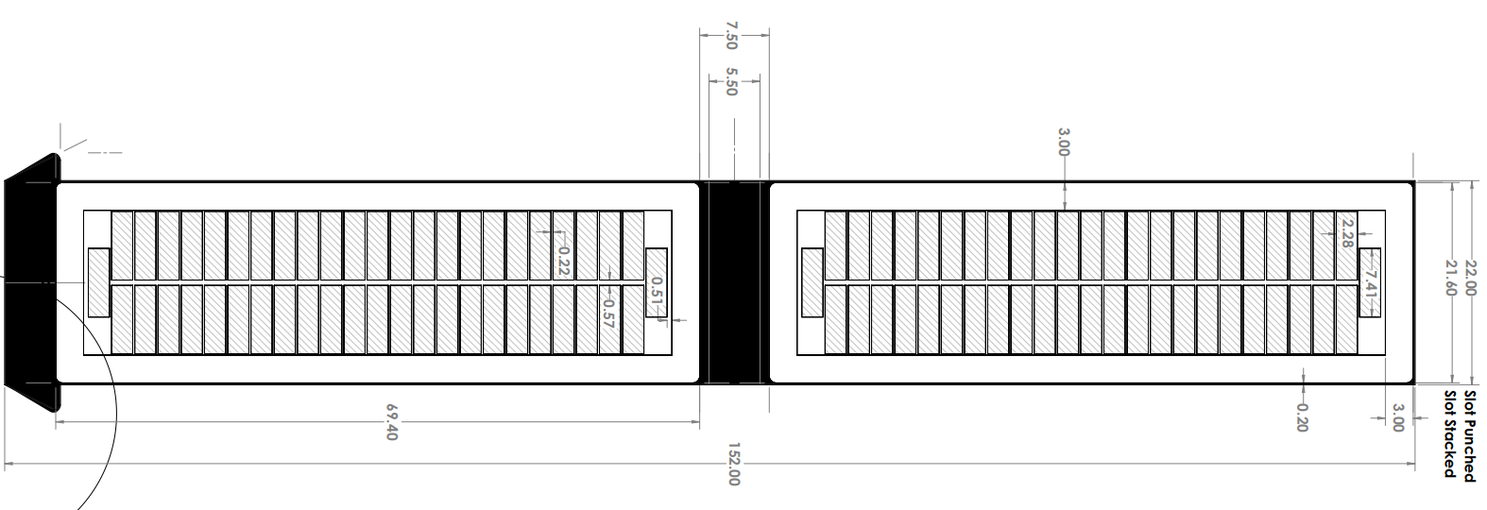
Design of Roebel Bars

Slide 19
Conclusion & Future Work
Refurbishment is important for sustanability
Cheapest way of increasing installed power
Roebel bars are used in wave windings
To reduce AC losses
Future Work: Optimization with different rotor geometries
Test of effect of production and different insulation materials
Thermal performance test of the winding

